Slide 1
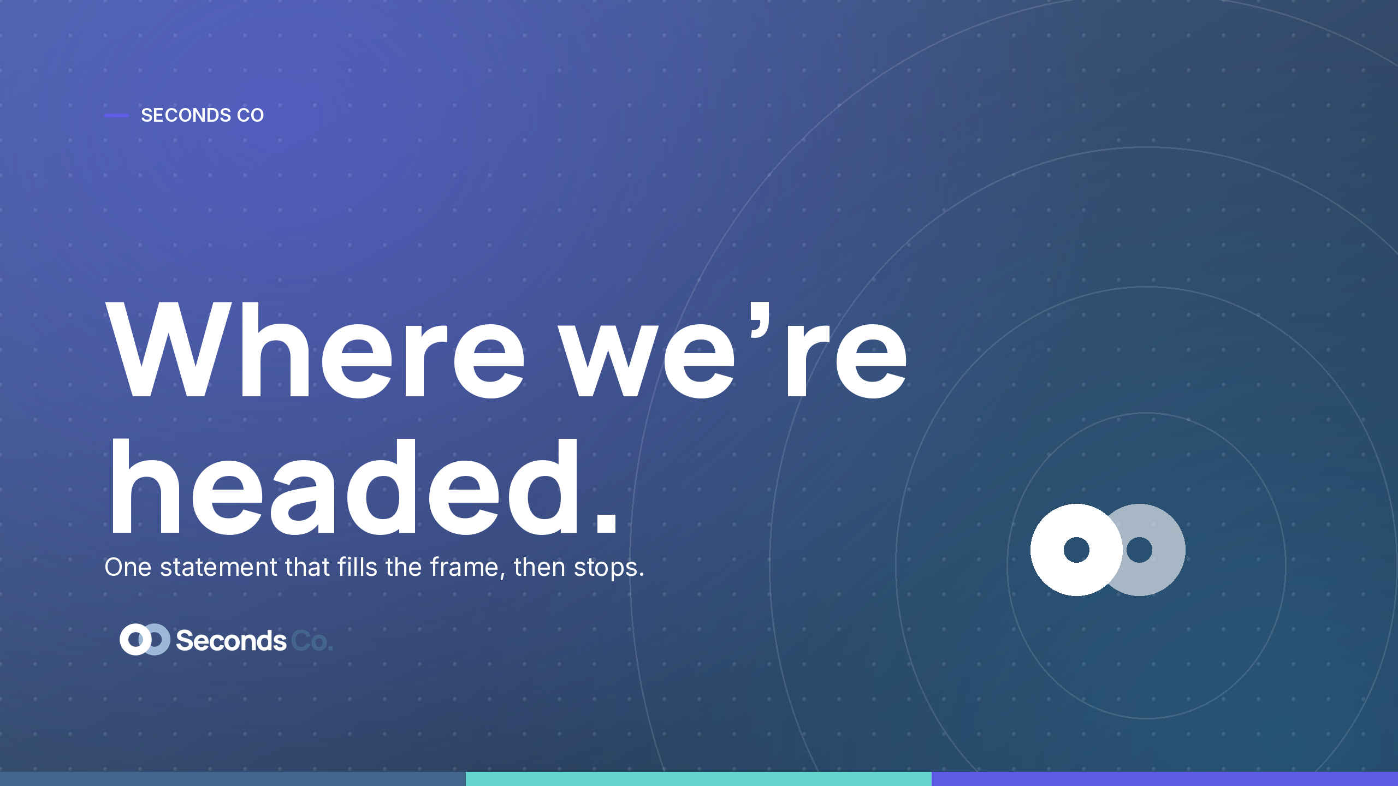

Slide 2





SECONDS CO · AGENDA
What we'll cover.
Where we're headed
The one statement, then the plan.
How we operate
The system that keeps the noise down.
By the numbers
What moved, plainly.
What we need
The asks, the owners, the dates.
The highest compliment is seconds.

Slide 3
SECTION 01
One statement that
fills the frame.
Say the plain thing, then stop.
One idea per line, in Inter.
The accent does the pointing, not the volume.
The highest compliment is seconds.

Slide 4
SECTION 02
By the numbers.
2×
0
100%
1
seconds served
orange, ever
on brand
system
The highest compliment is seconds.

Slide 5
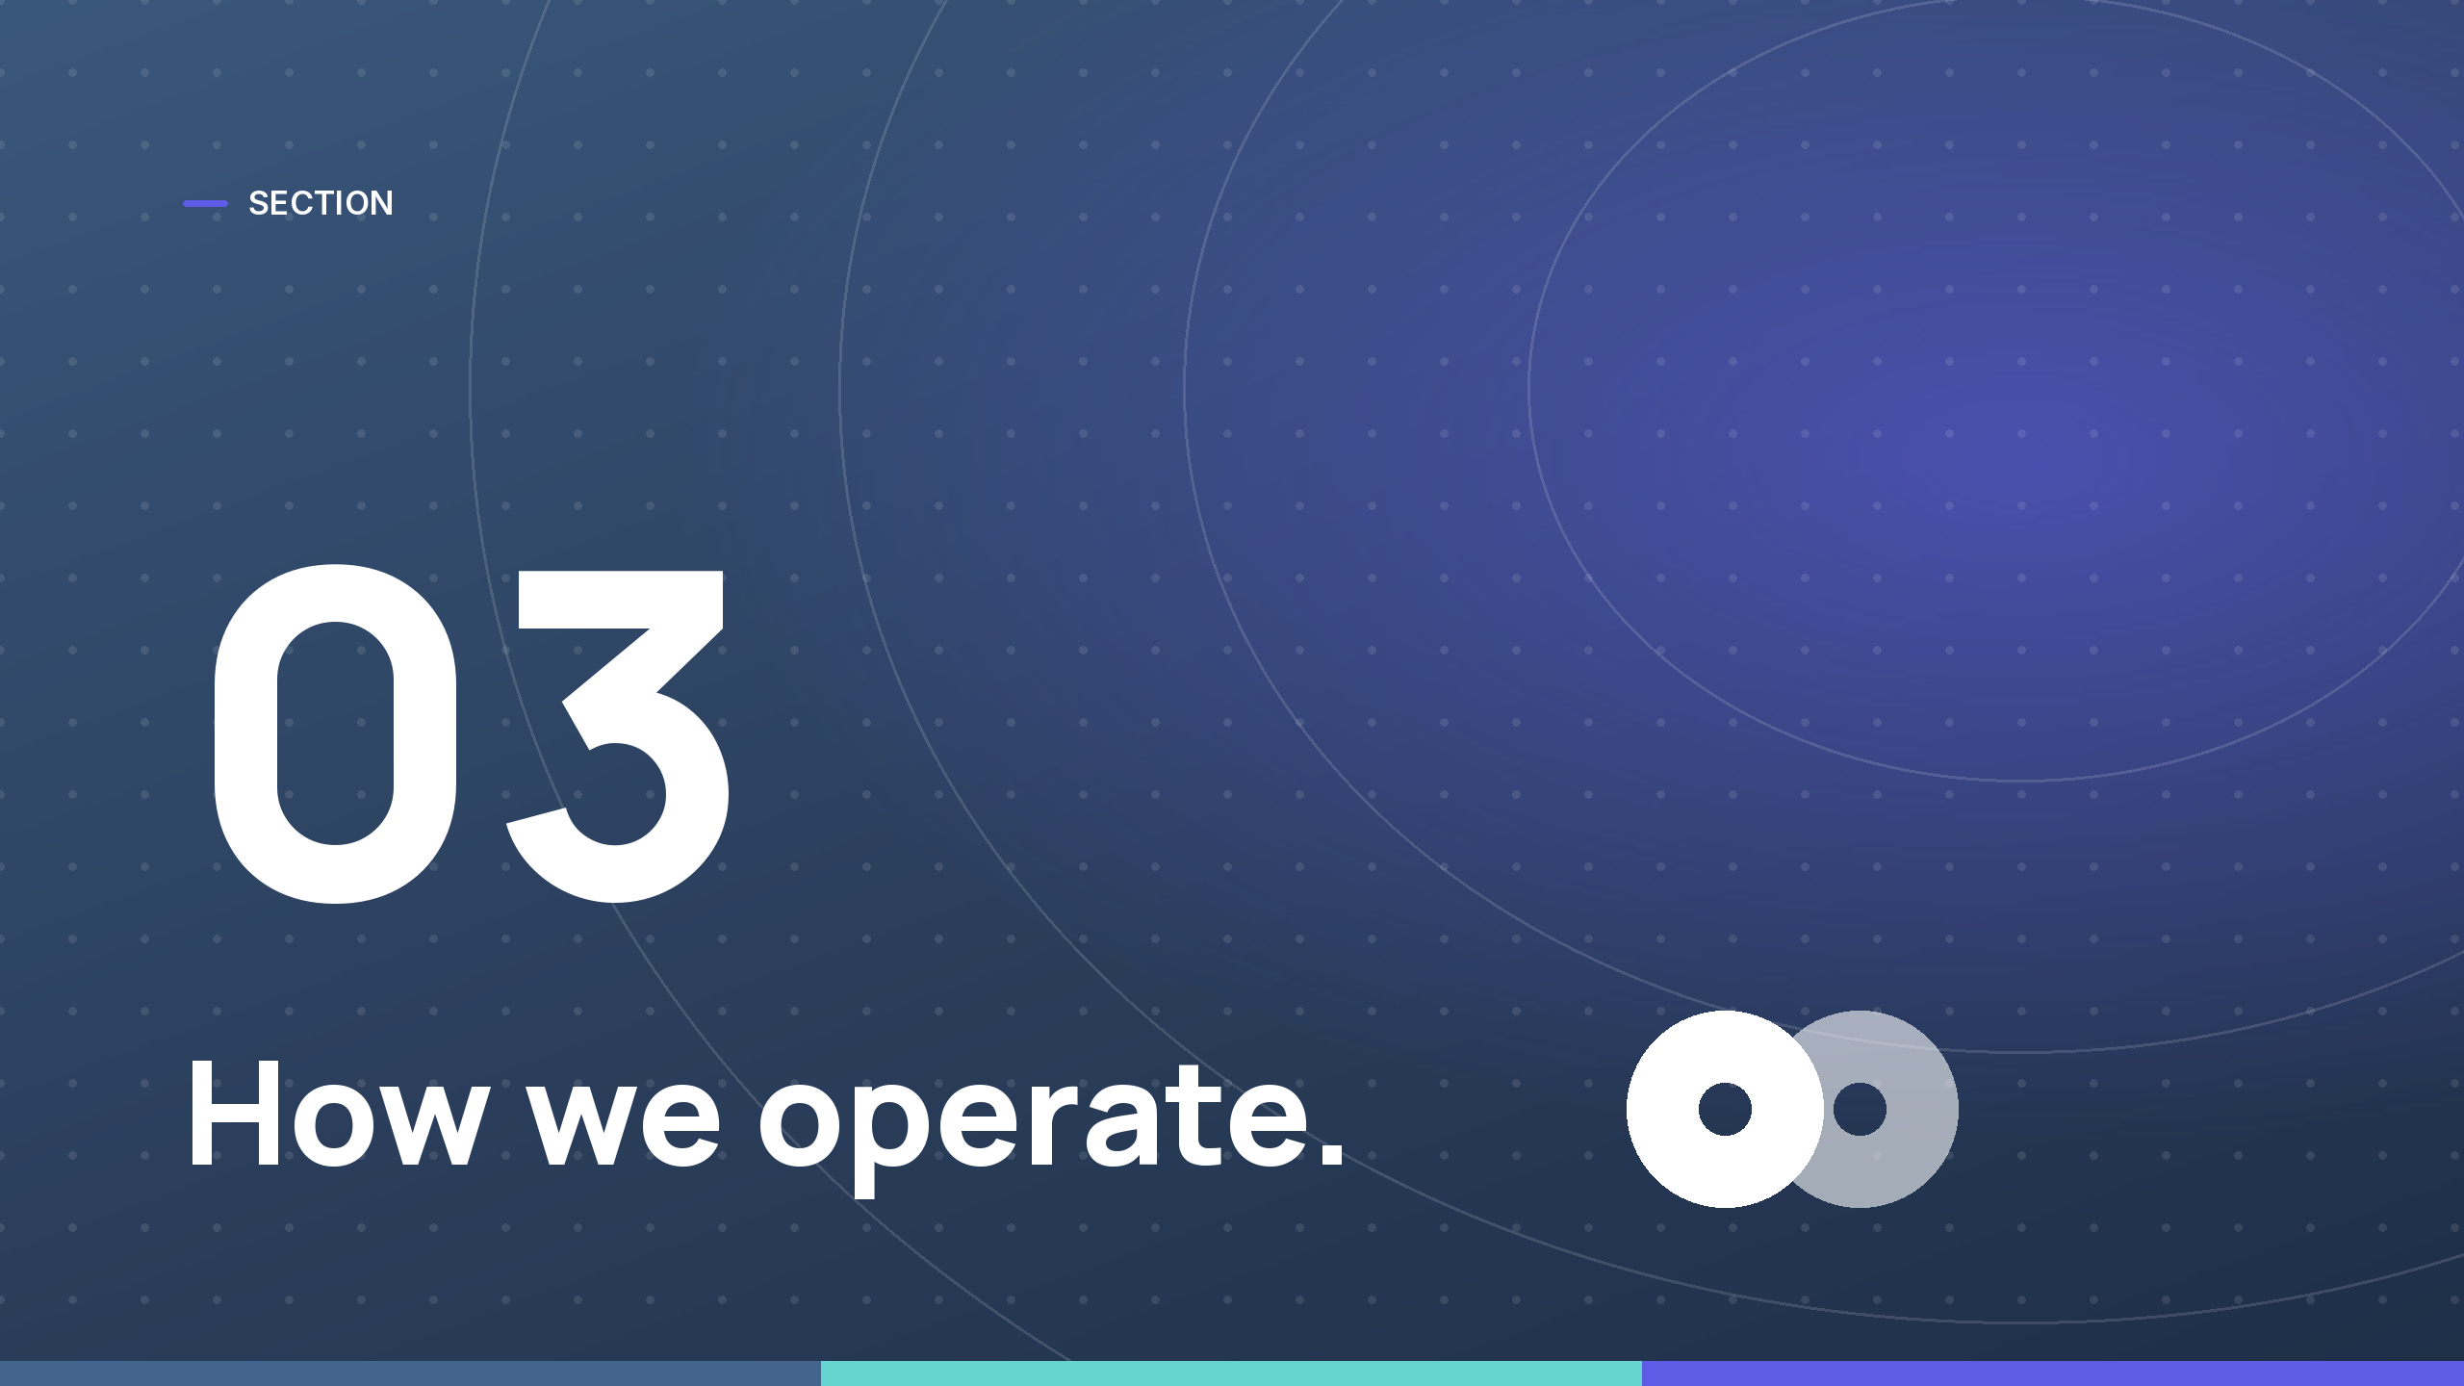

Slide 6


